Slide 1
IDS PROJECT
TEAM:-
1)SAKSHI VATTIKUTI PES2201800157
2)VINEETH BODDUVARAM PES2201800046
3)MANISH M PES2201800428

Slide 2
DATASET USED:-
The dataset we have used for our project is the life expectancy dataset. It tries to correlate factors such as schooling, immunization coverage, the average consumption alcohol and other such factors with the average life expectancy of a particular country.

Slide 3
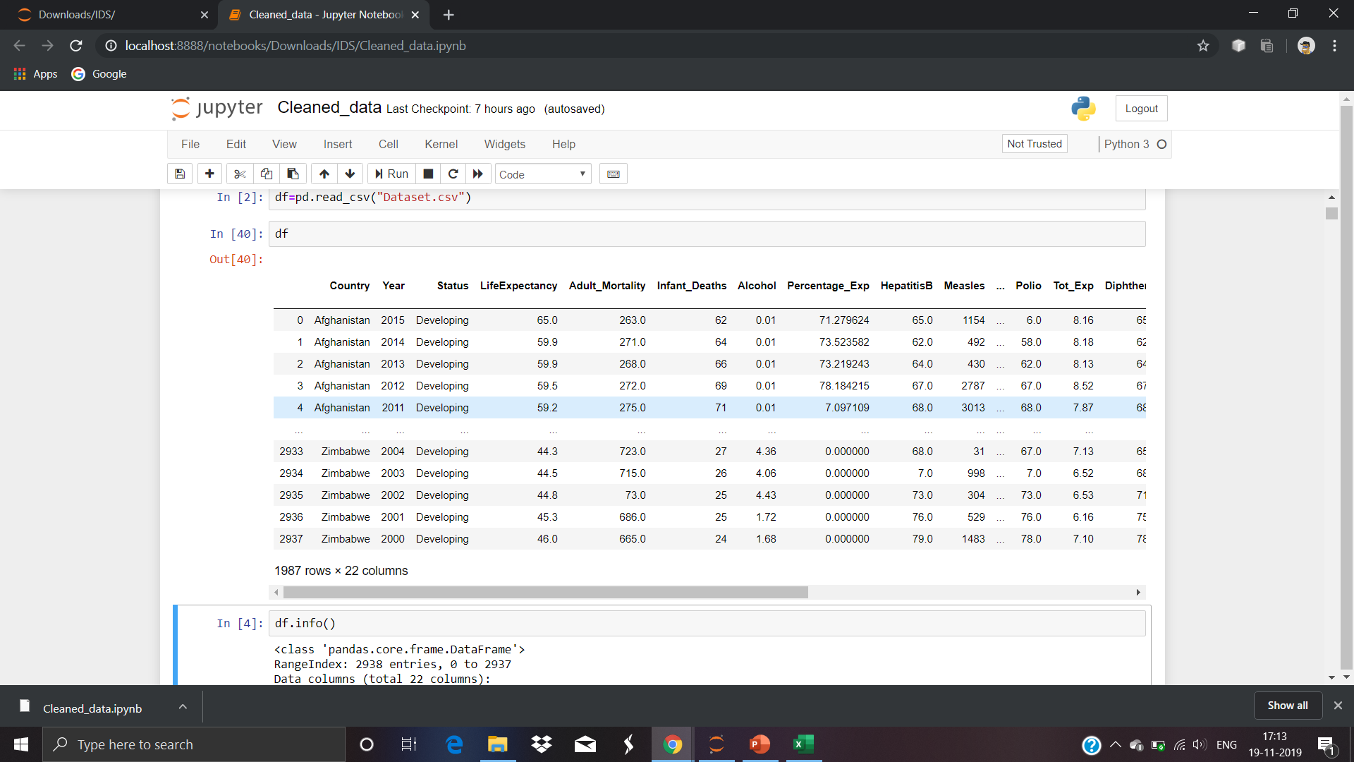
REPRESENTATION OF RAW DATASET

Slide 4
CLEANING OF THE DATASET
We have cleaned the dataset by using two different methods
1)By replacing NaN by median
2)By interpolation:- Interpolation is a method where it fills the NaN values within a given a range without the user hard-coding it.

Slide 5
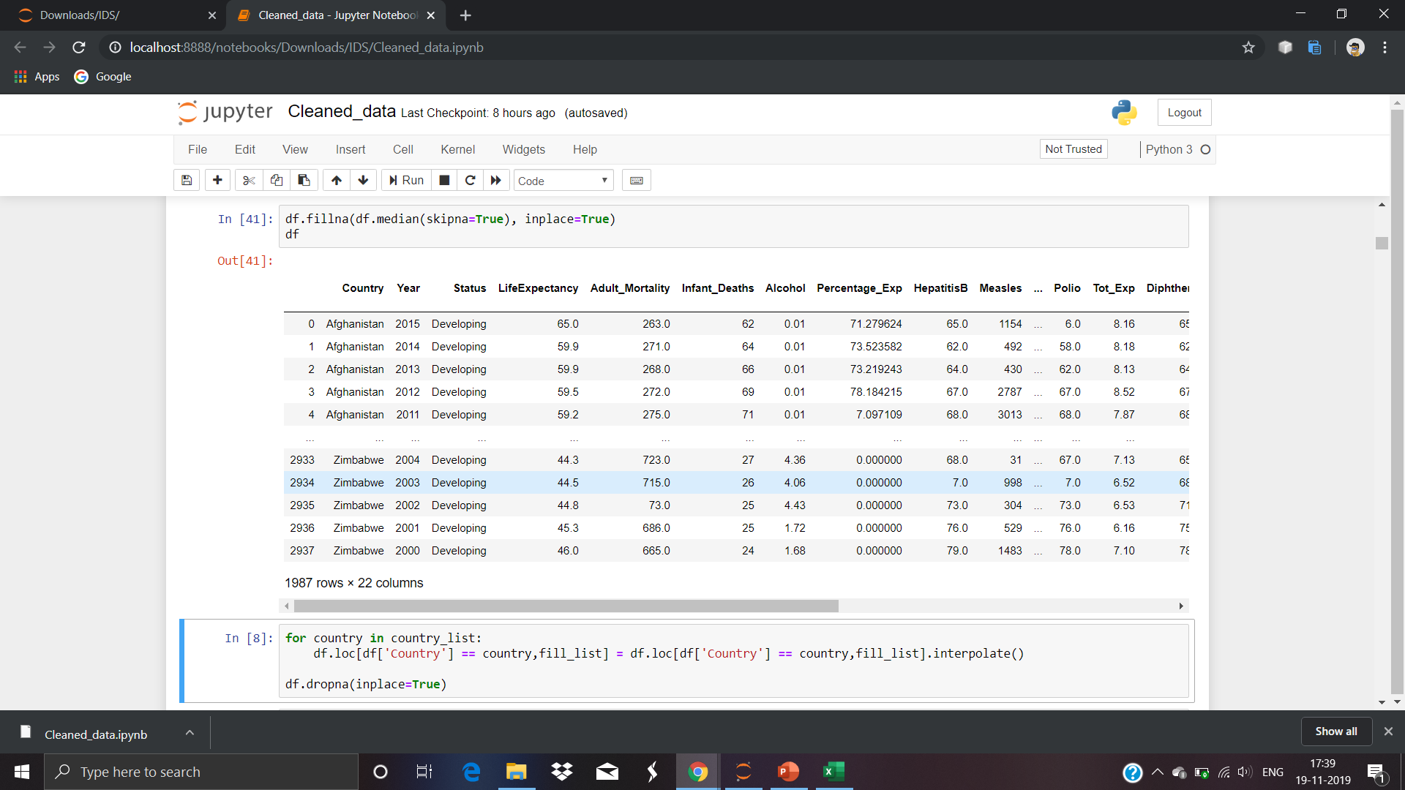
REPLACING NaN BY MEDIAN

Slide 6
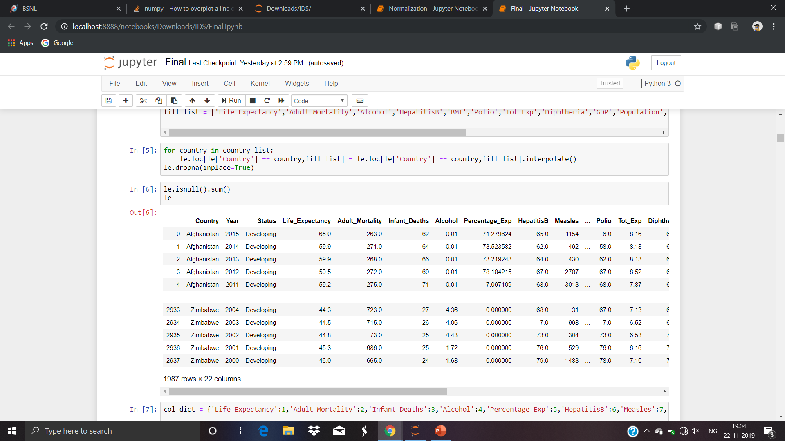
INTERPOLATION

Slide 7
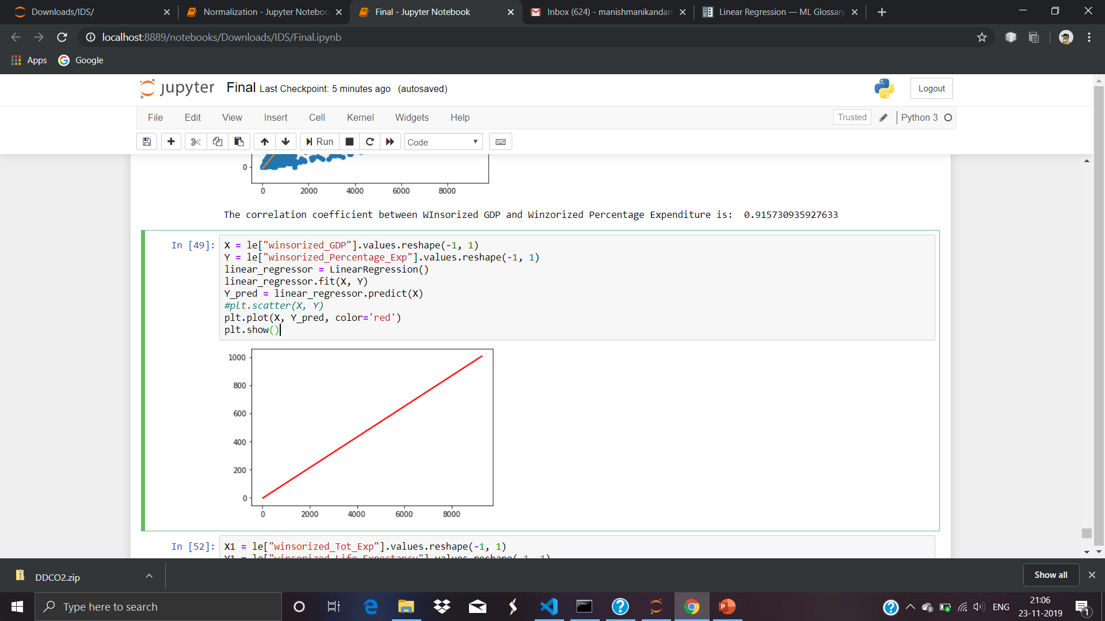
LINEAR REGRESSION

Slide 8
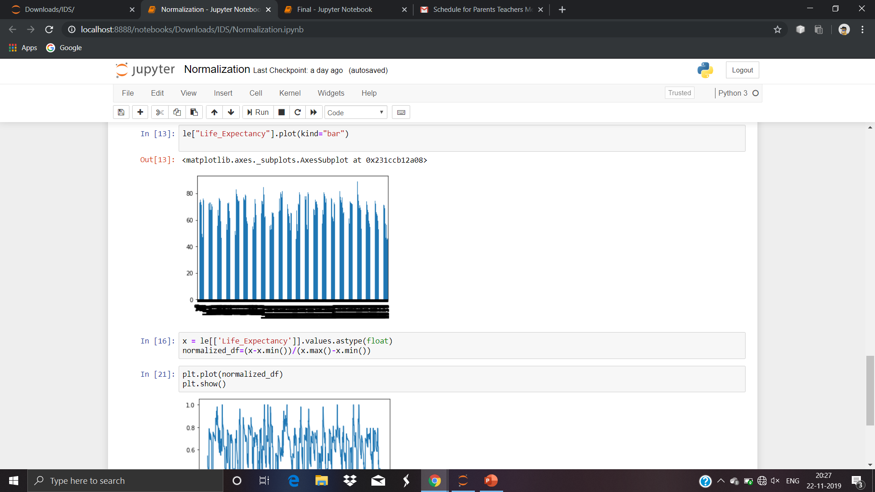
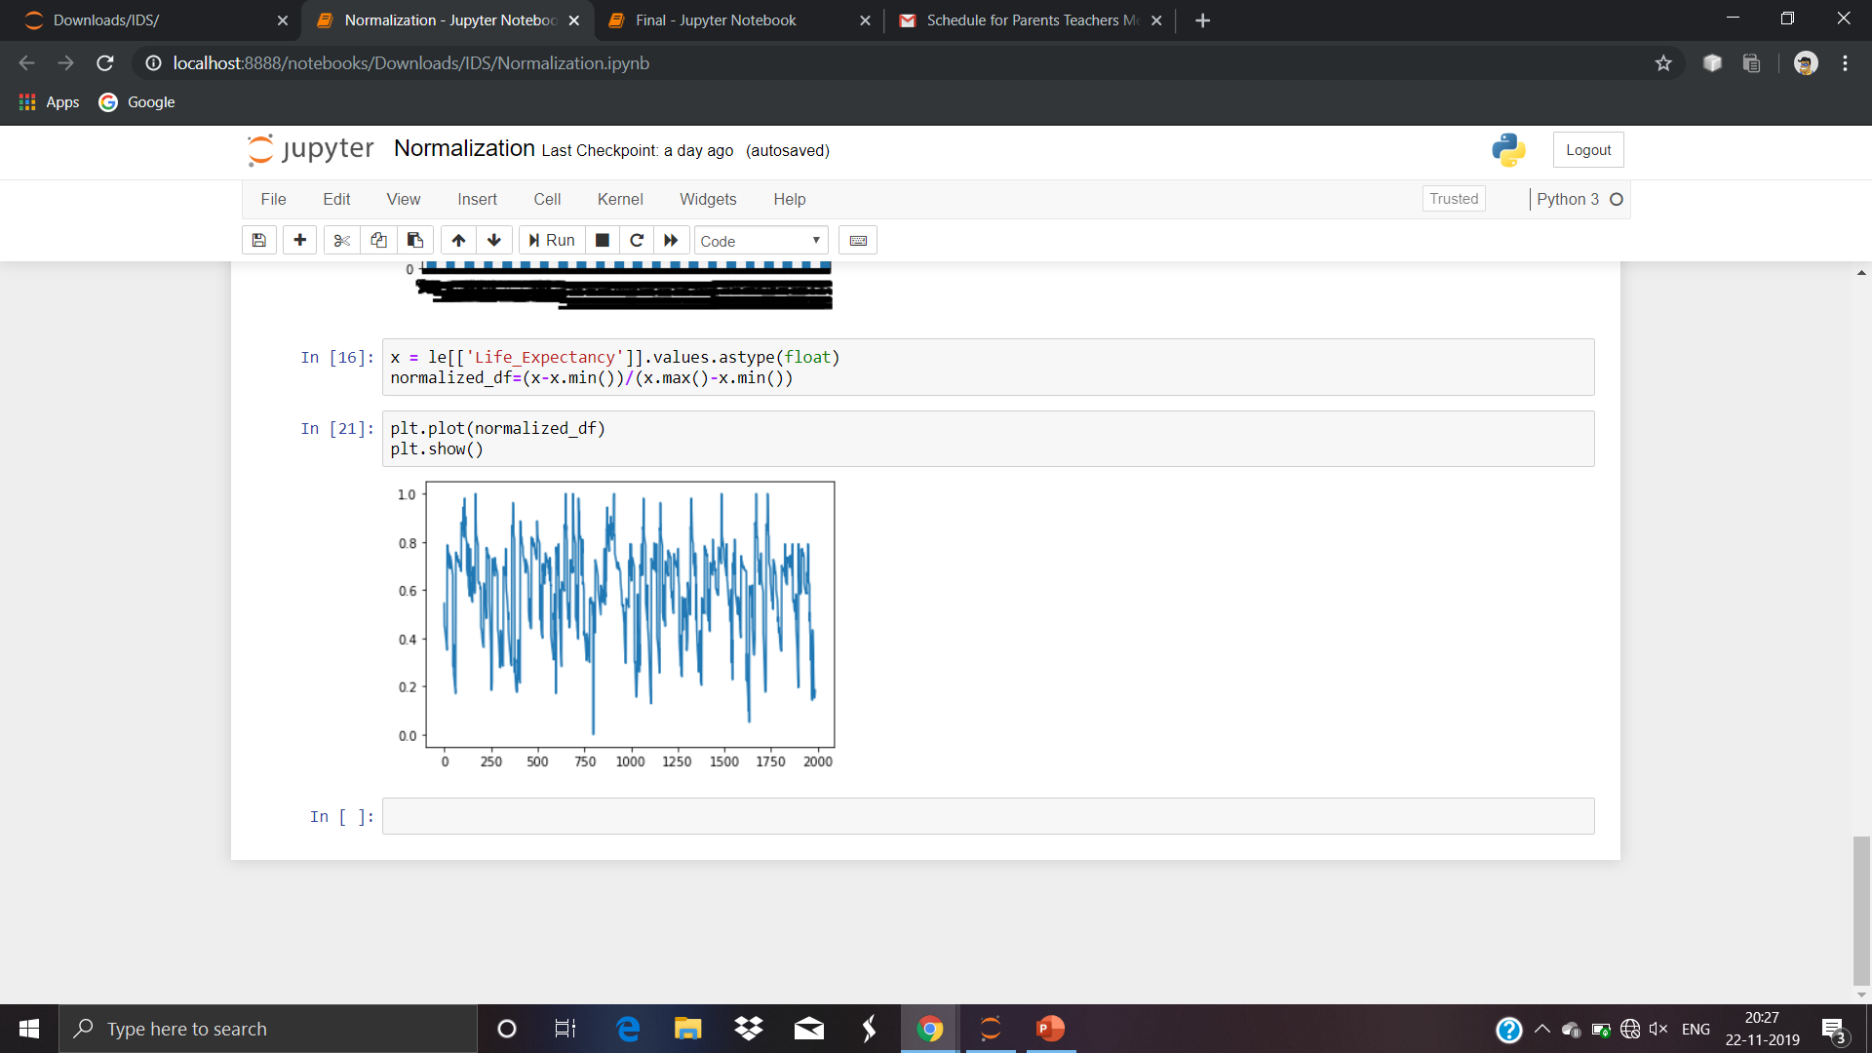
NORMALIZATION

Slide 9
OUTLIERS
An outlier is an observation that deviates from the other observations on the data.
Outliers must be removed from the dataset to obtain better graphs.
We are going to remove outliers by using the Winsorization technique.

Slide 10
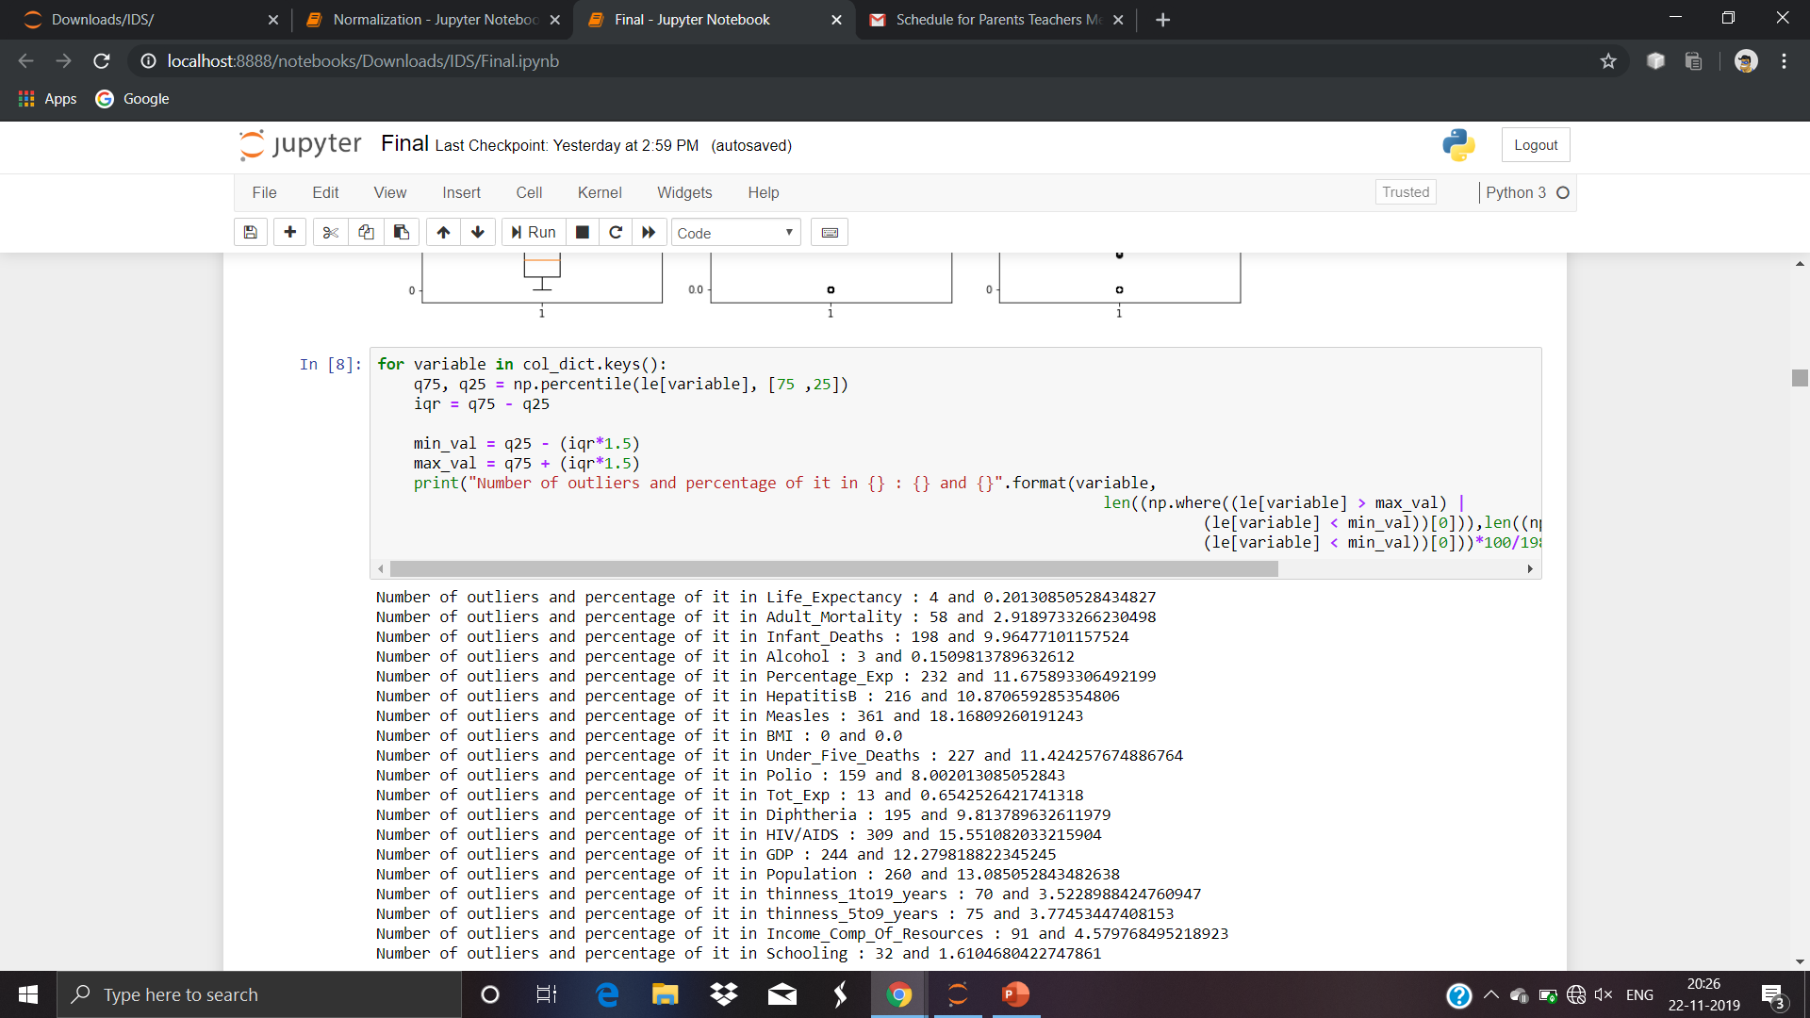
FINDING THE NUMBER OF OUTLIERS USING TUKEY’S METHOD

Slide 11
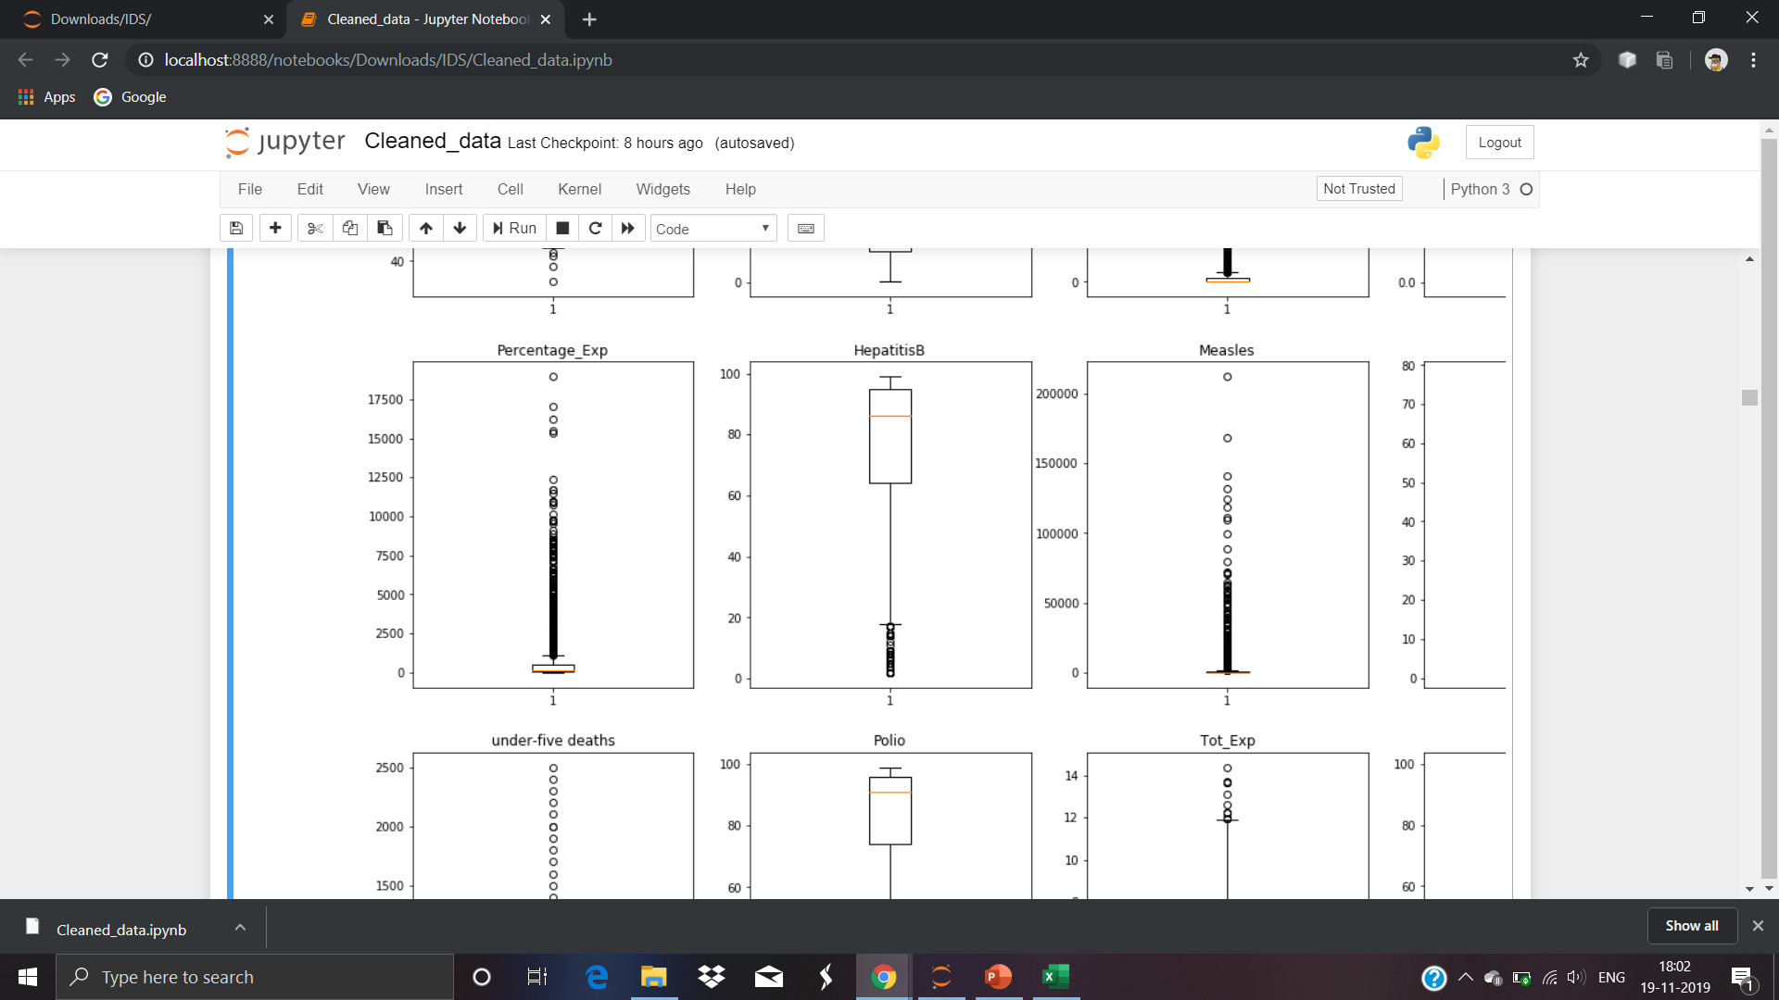
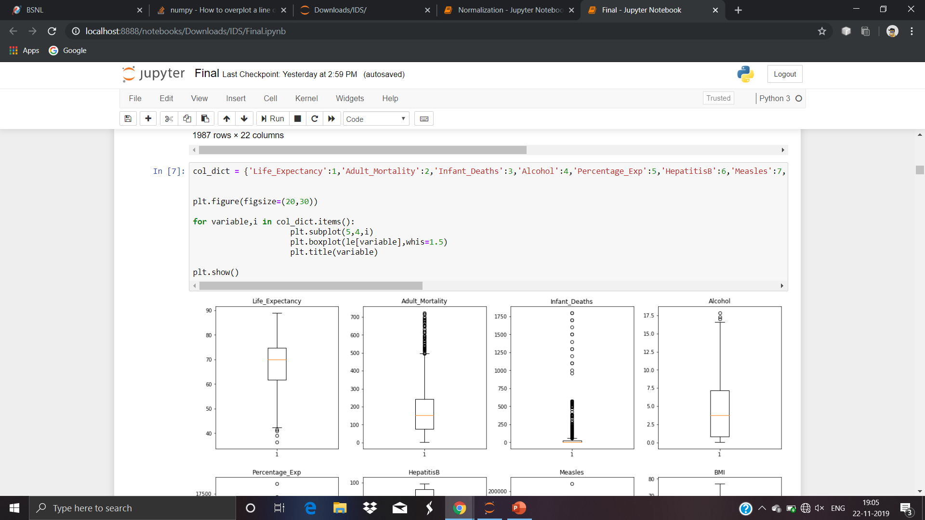
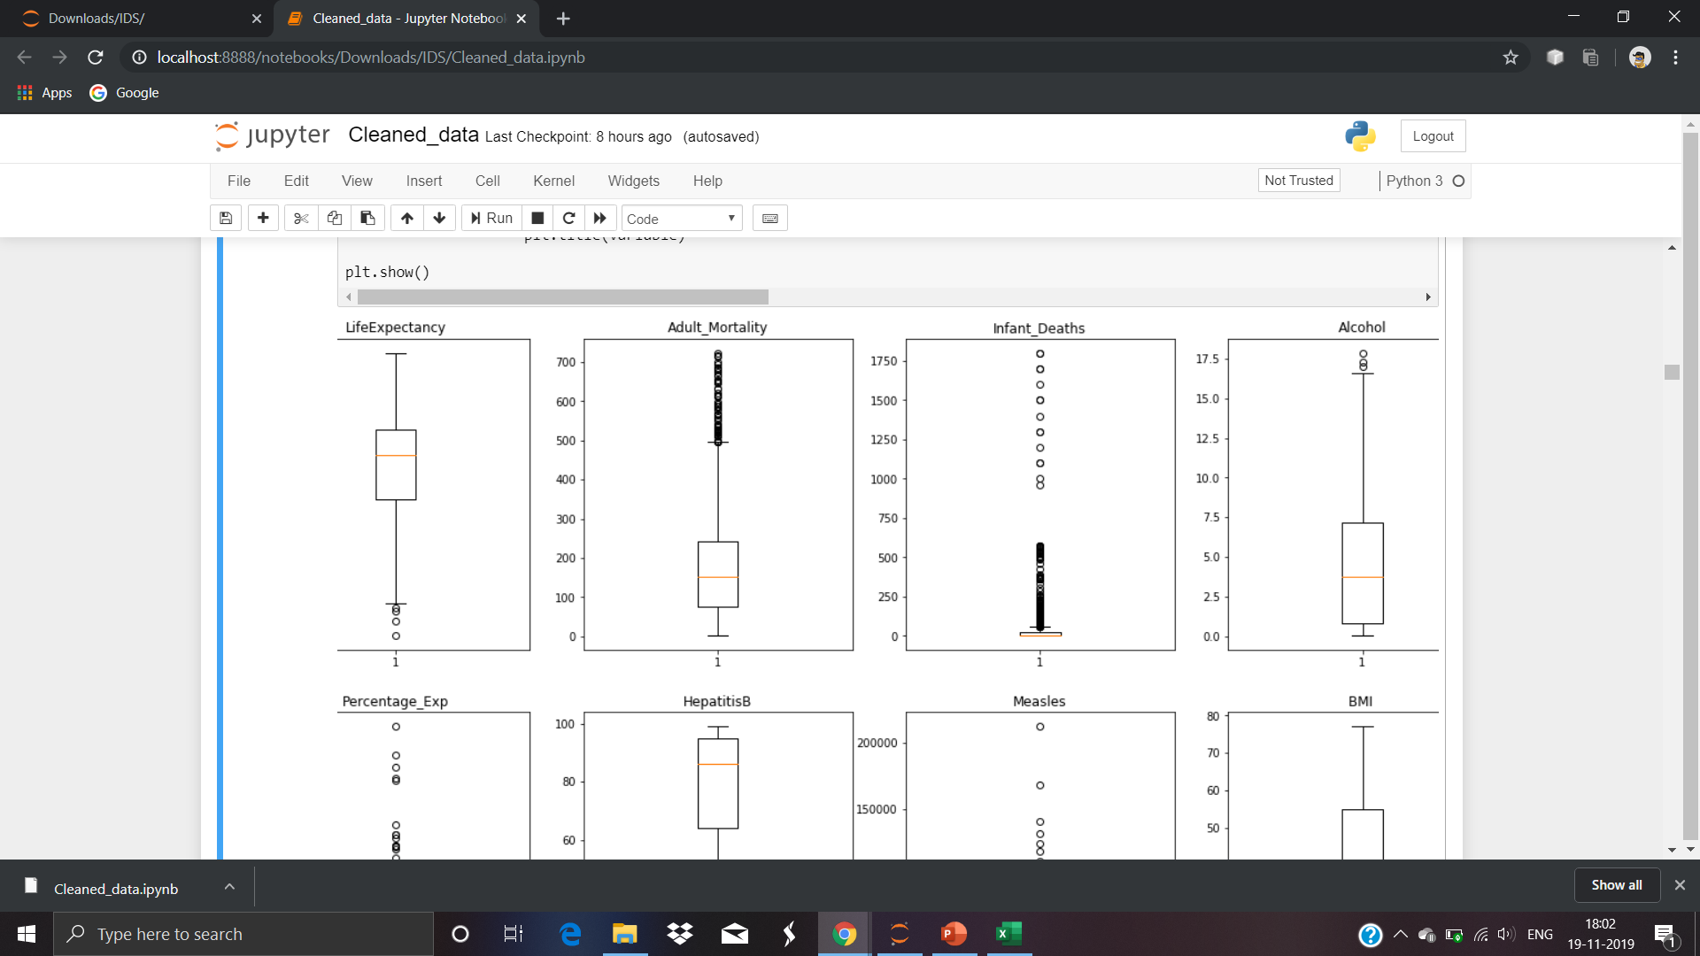
BOX PLOTS WITH OUTLIERS IN THE DATA

Slide 12
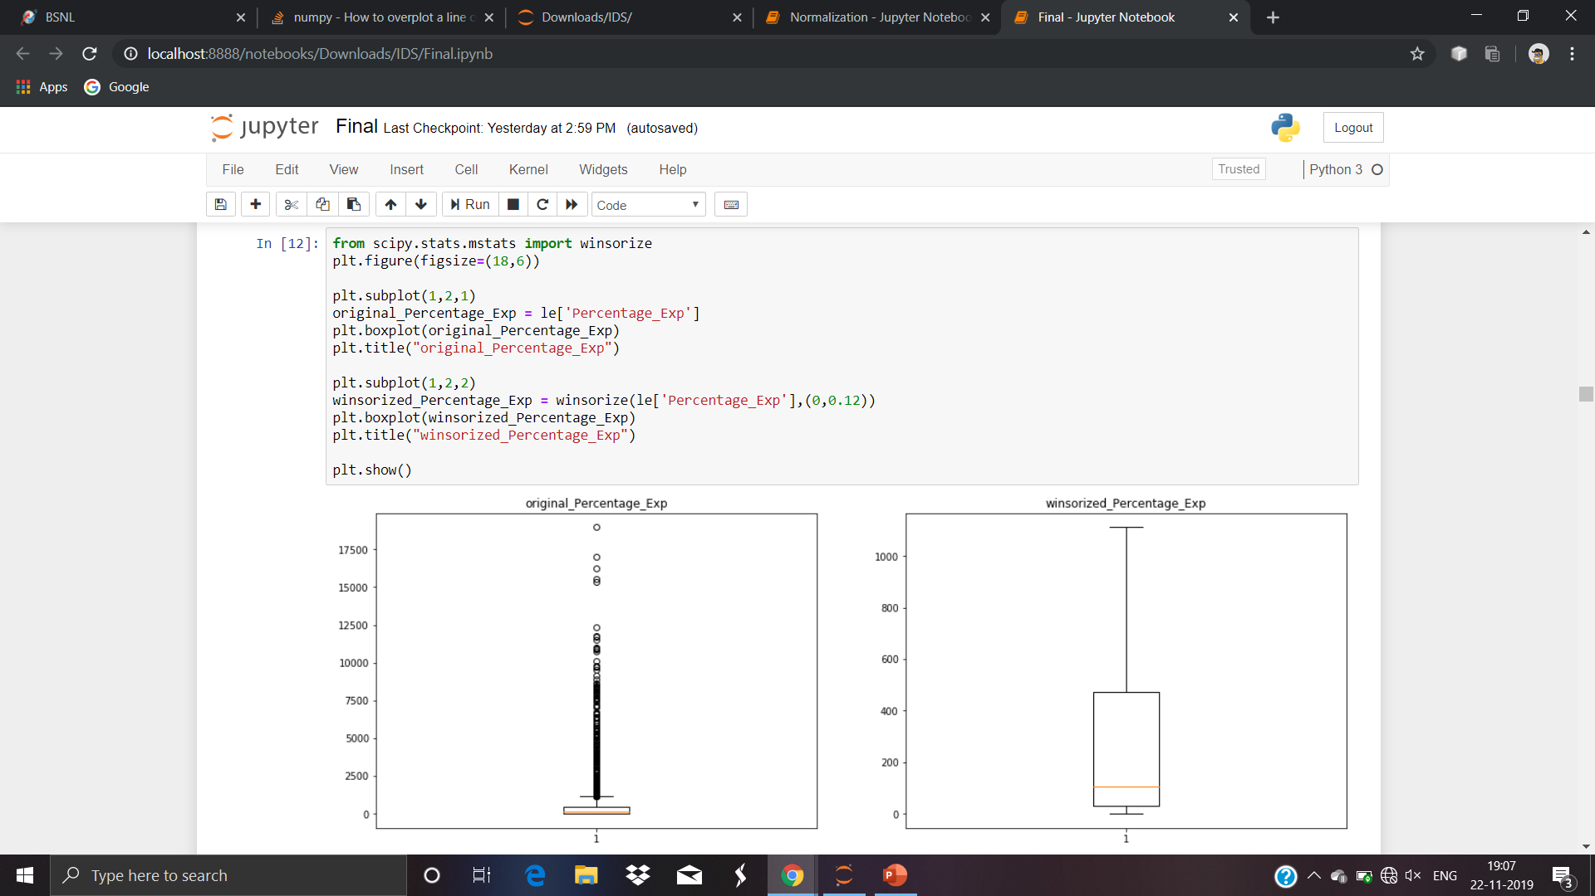
WINSORIZATION
Winsorization is a method where we replace the extreme values are replaced by certain percentiles.

Slide 13
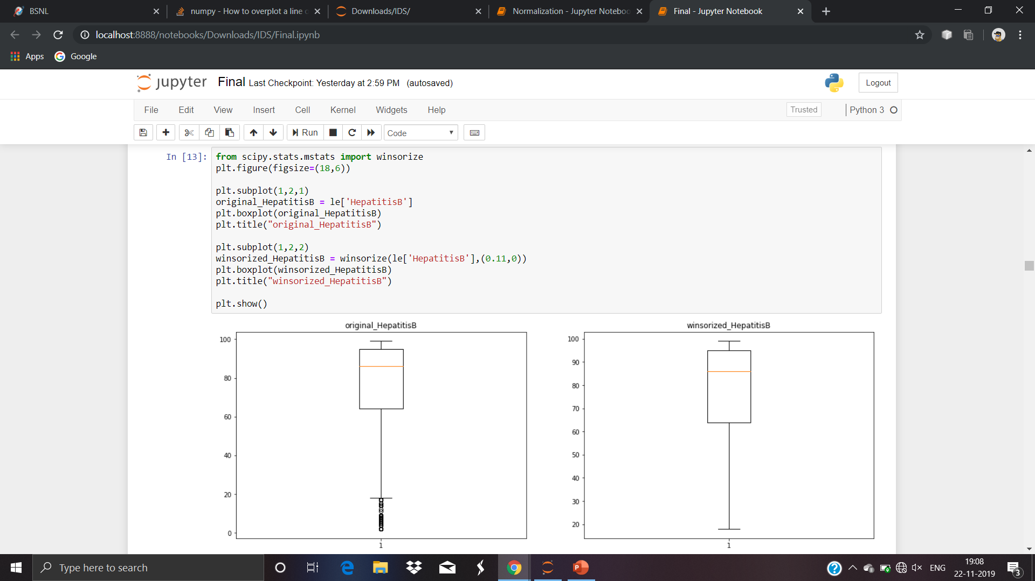
EFFECTS OF WINSORIZATION ON A BOX PLOT

Slide 14
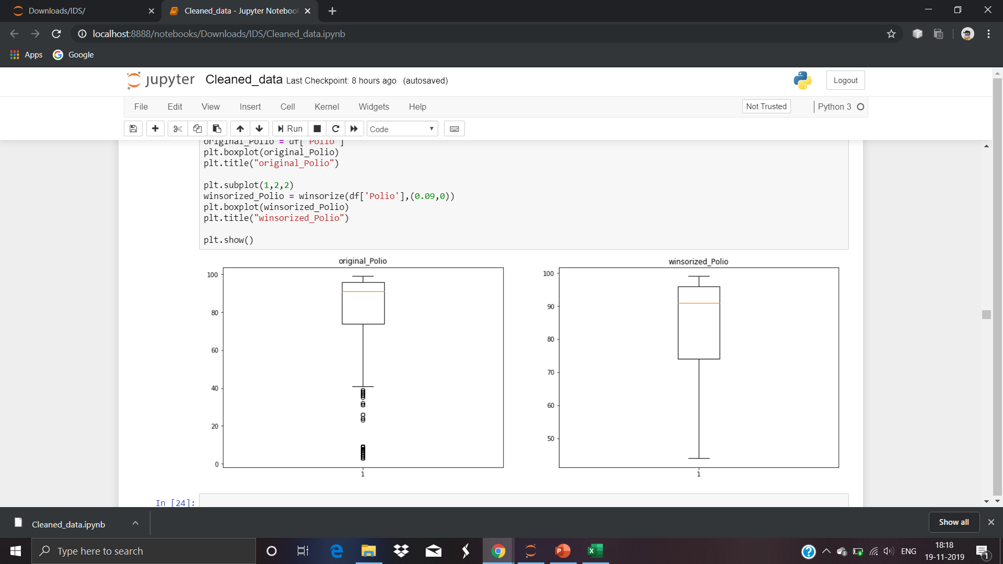

Slide 15
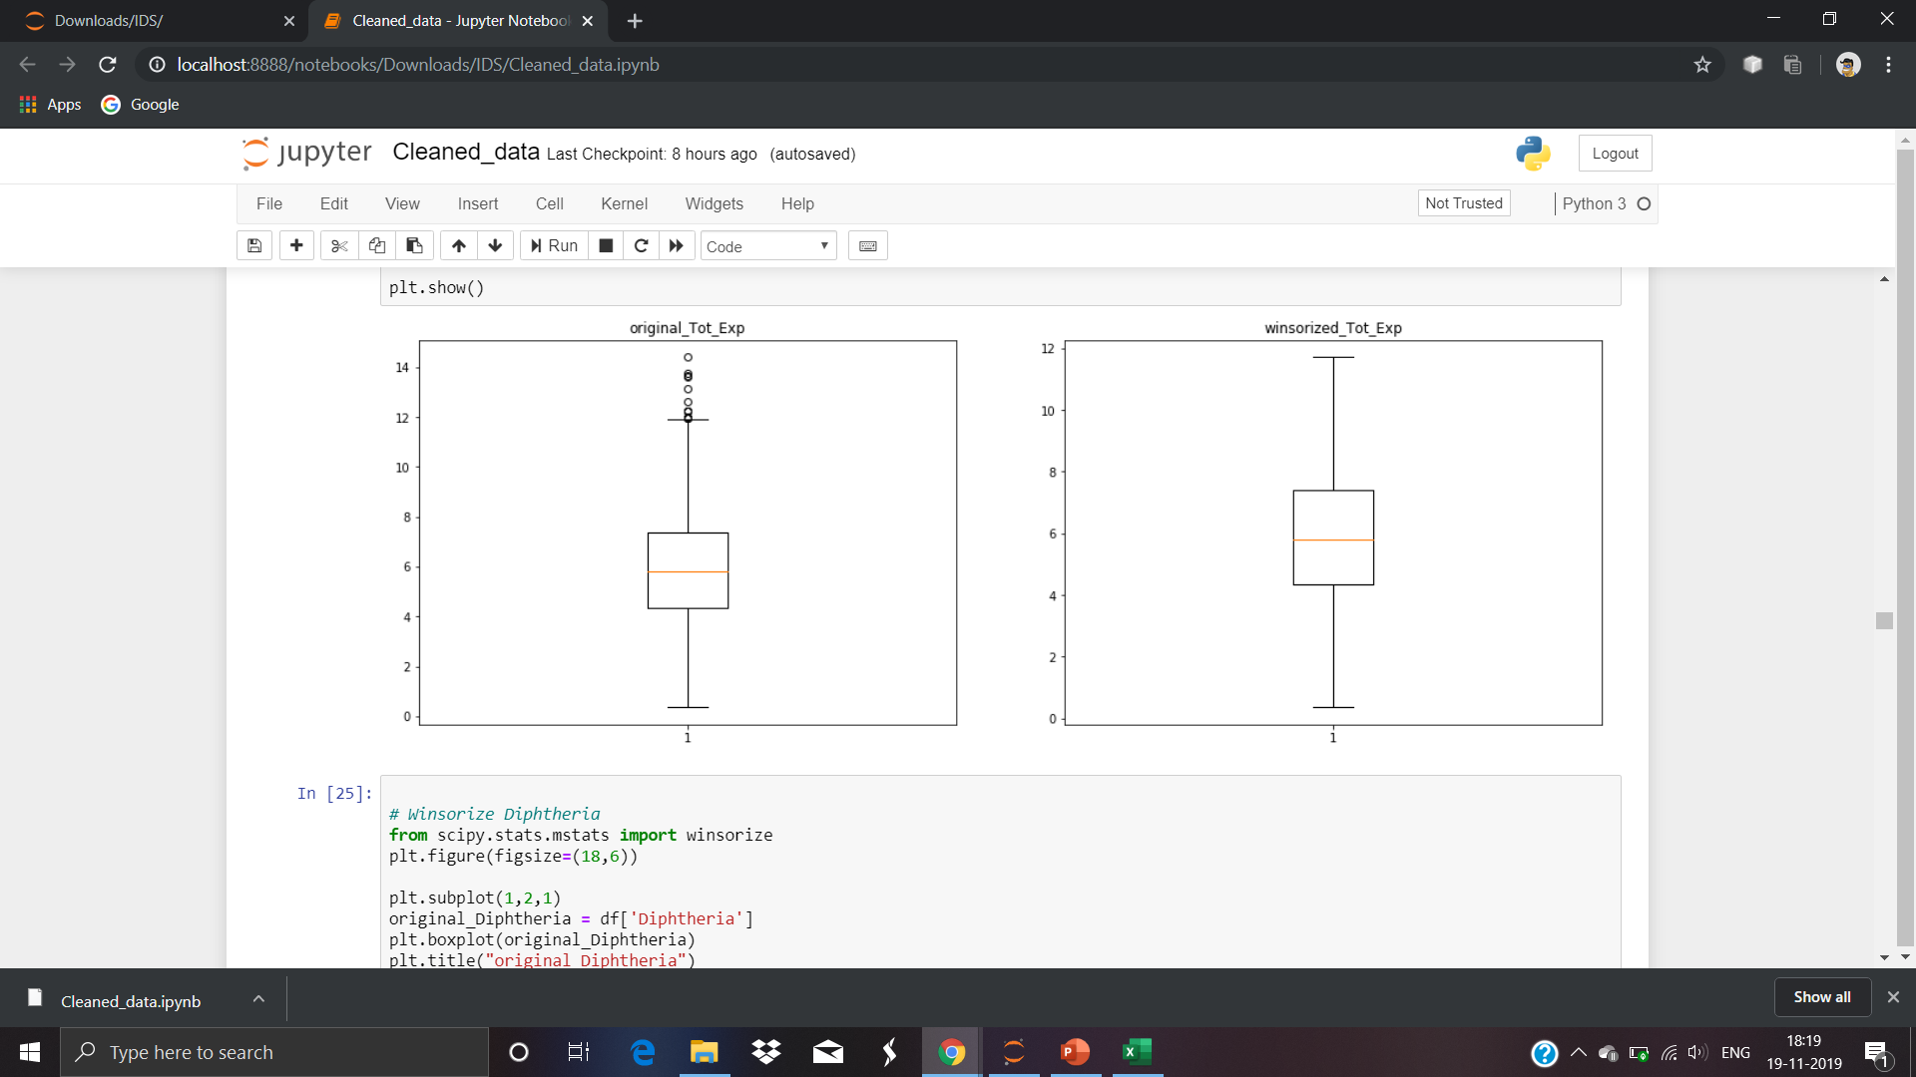

Slide 16
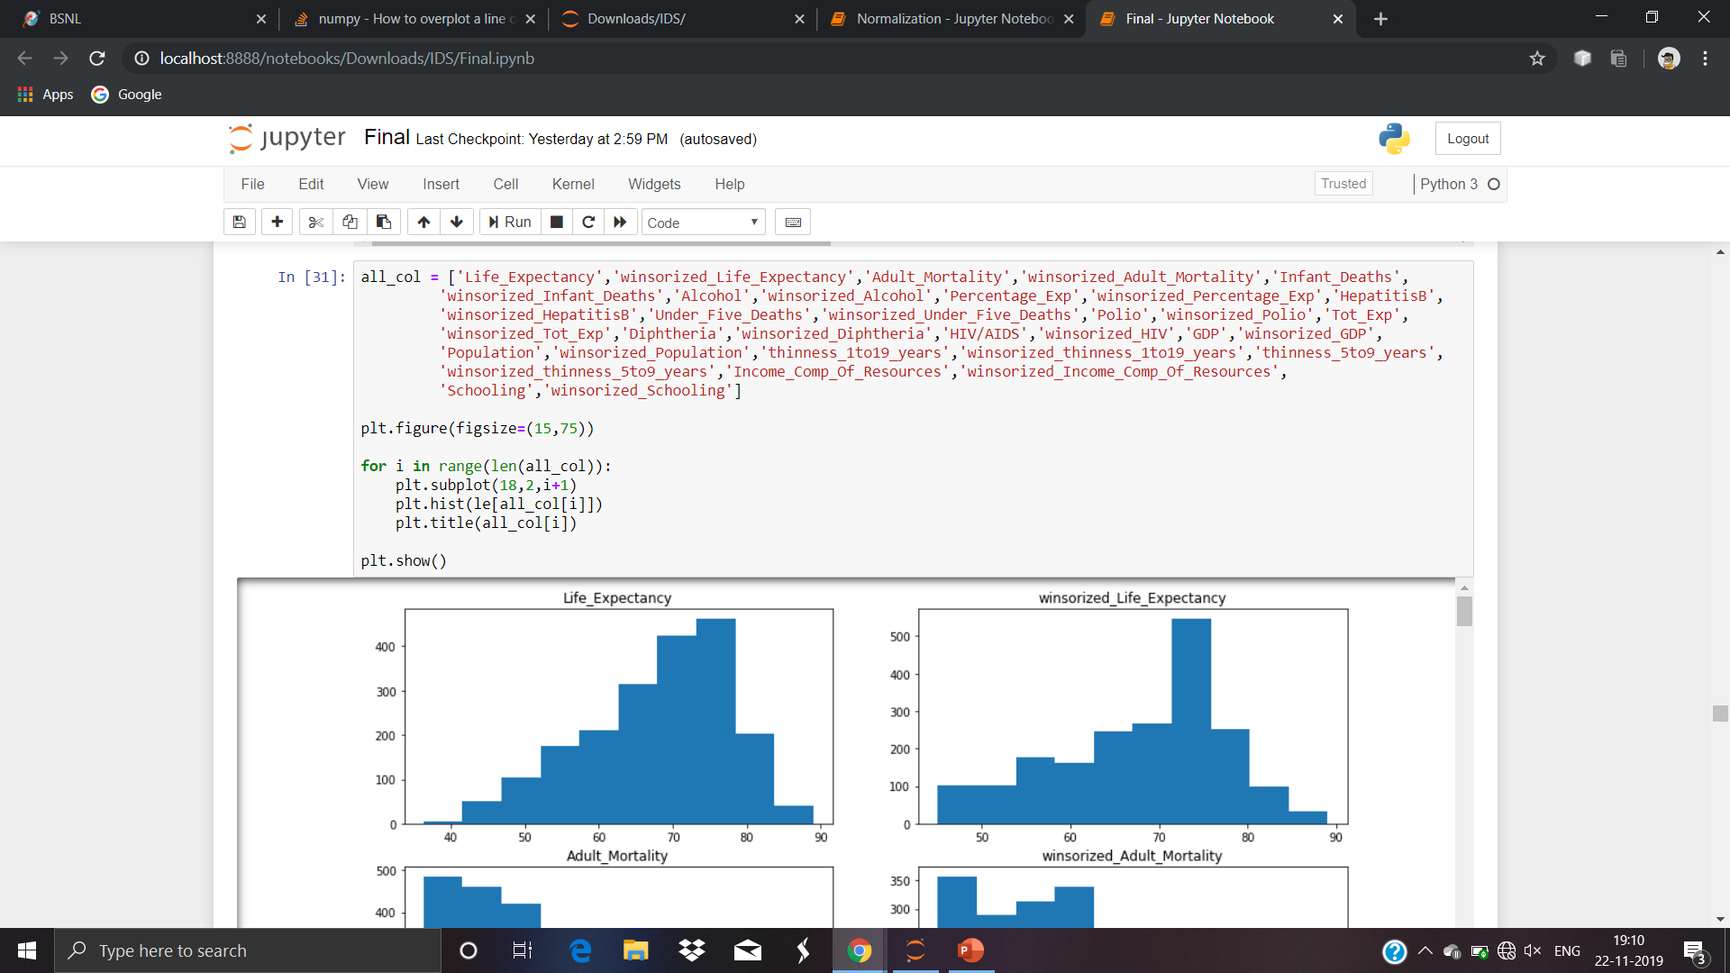
EFFECTS OF WINSORIZATION ON A HISTOGRAM

Slide 17
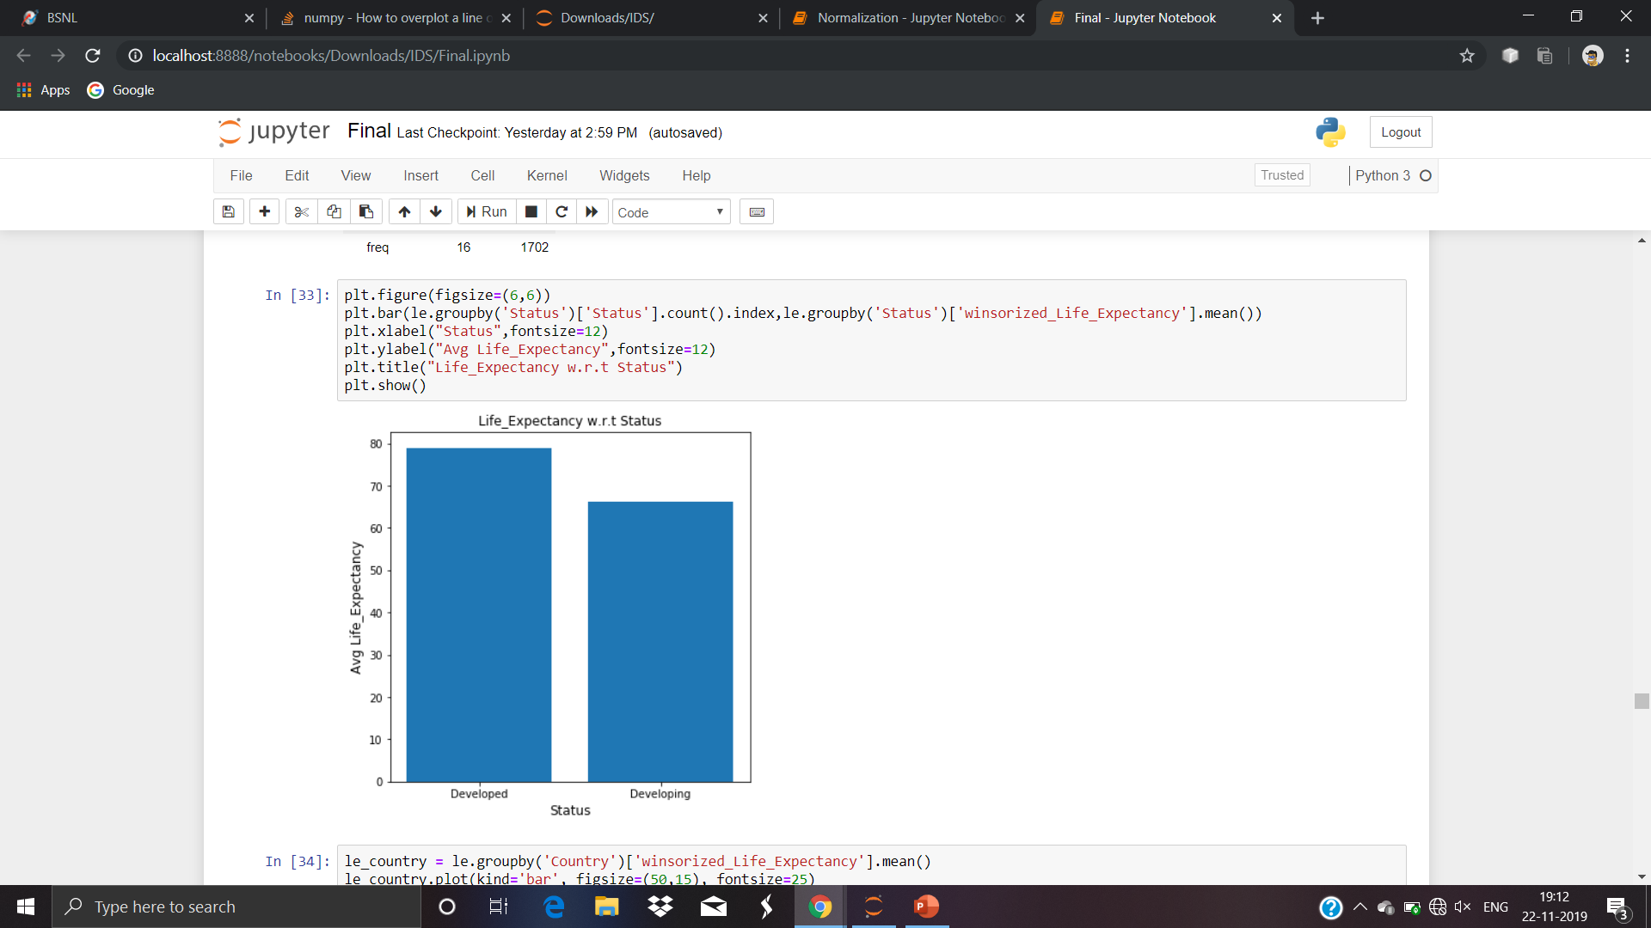
PLOTTING LIFE EXPECTANCY WITH RESPECT TO STATUS

Slide 18
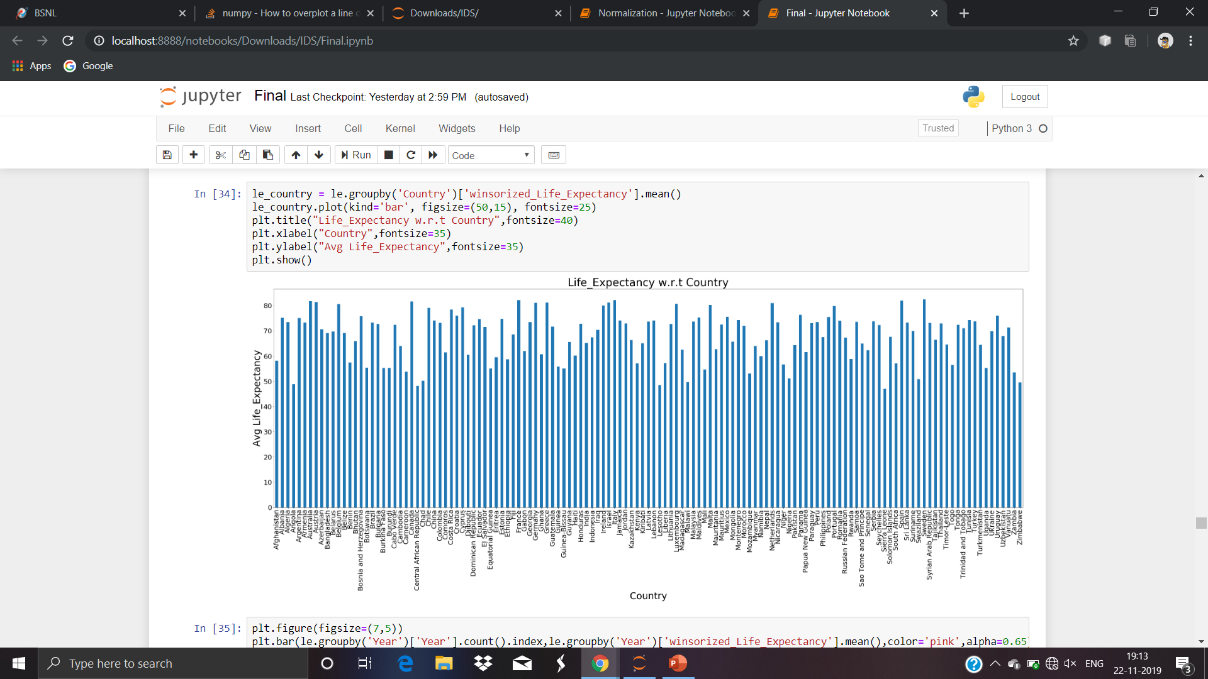
PLOTTING LIFE EXPECTANCY WITH RESPECT TO COUNTRY

Slide 19
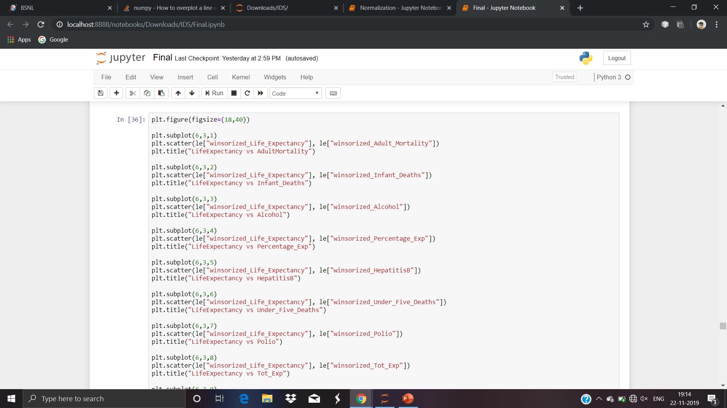
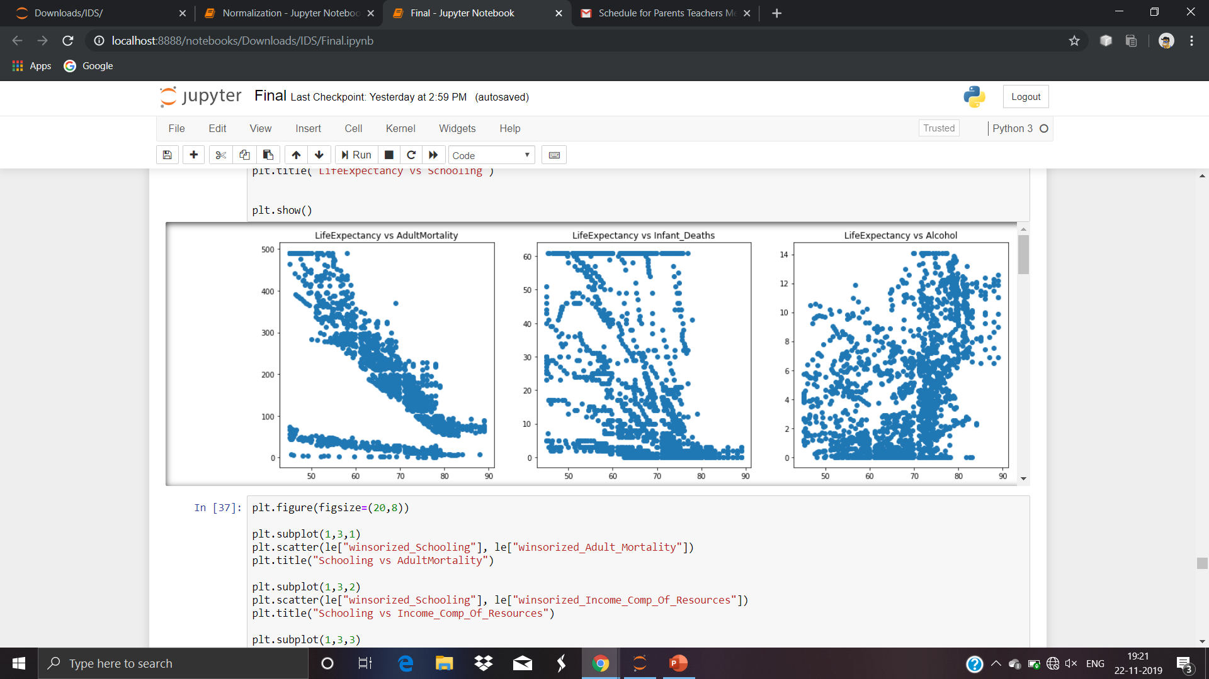
SCATTER PLOTS OF LIFE EXPECTANCY VERSUS THE CONTINUOUS VARIABLES

Slide 20
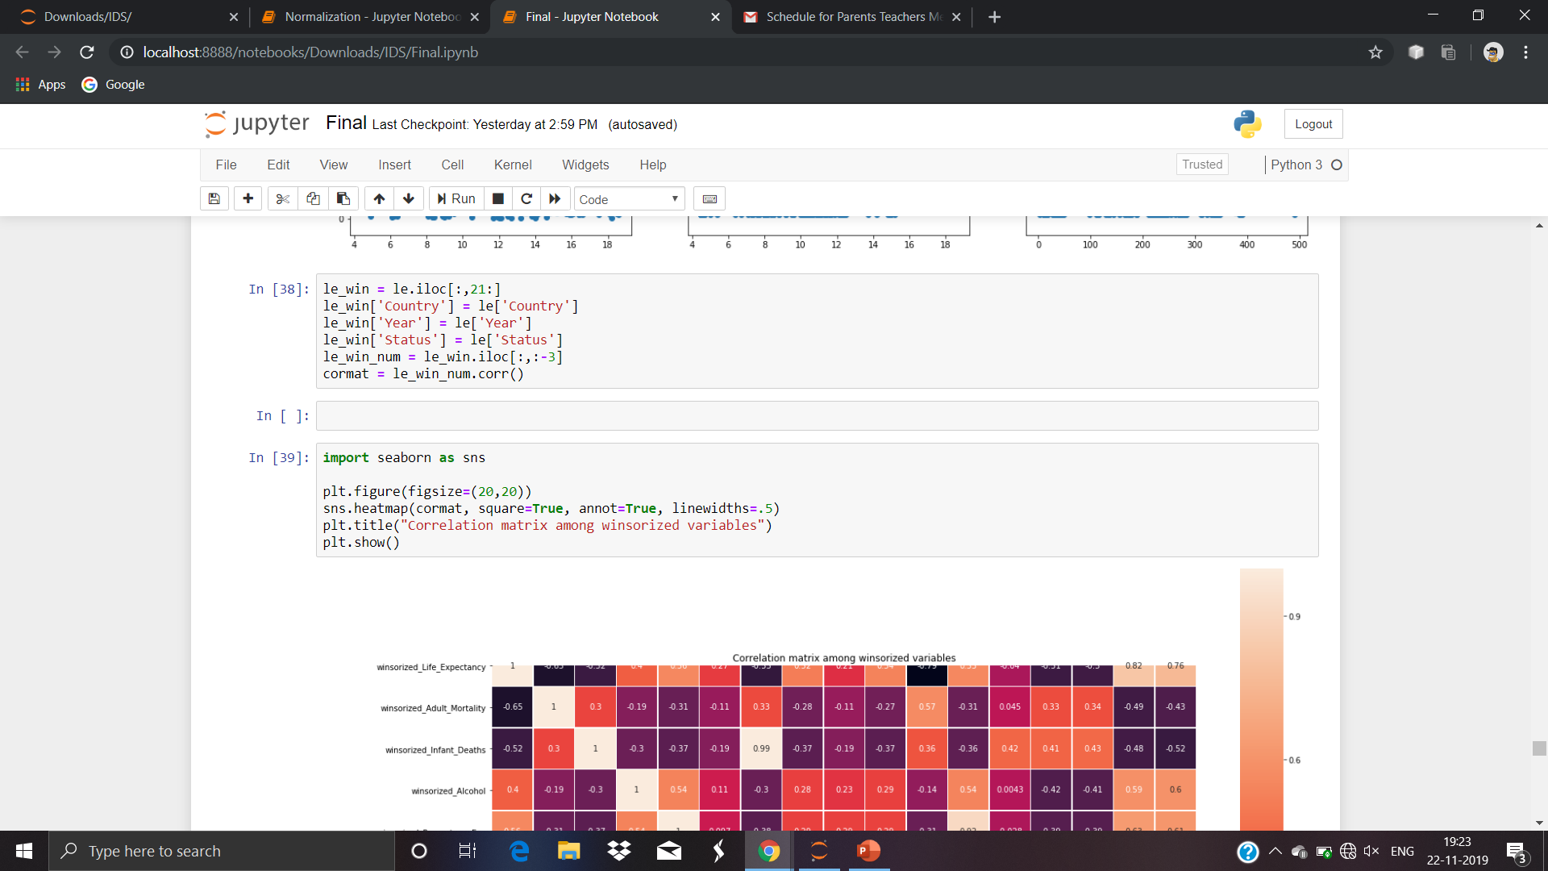
CORRELATION MATRIX AMONG THE WINSORIZED VARIABLES

Slide 21
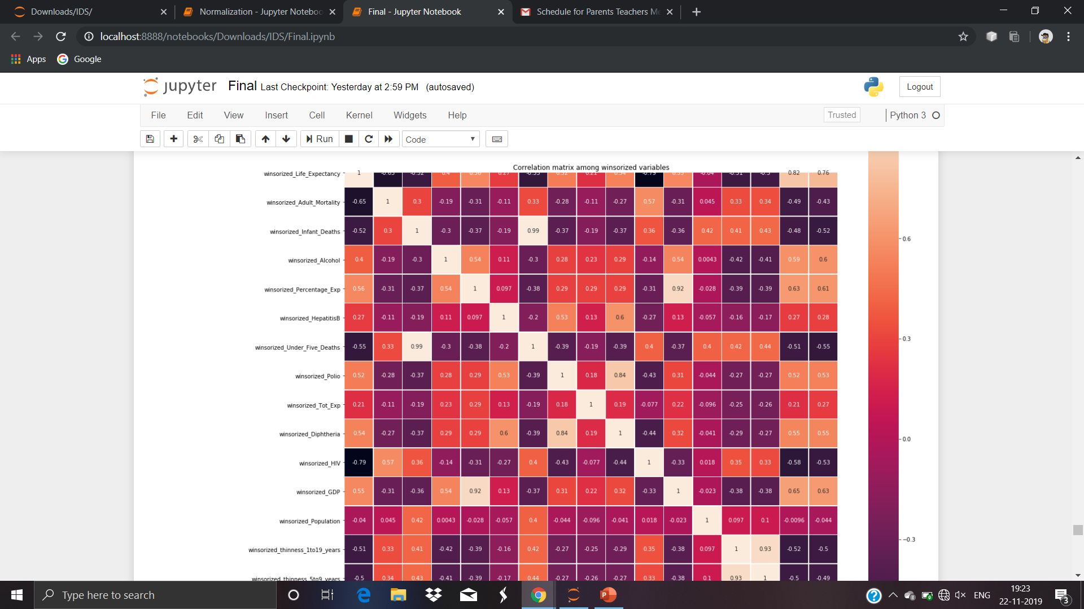

Slide 22
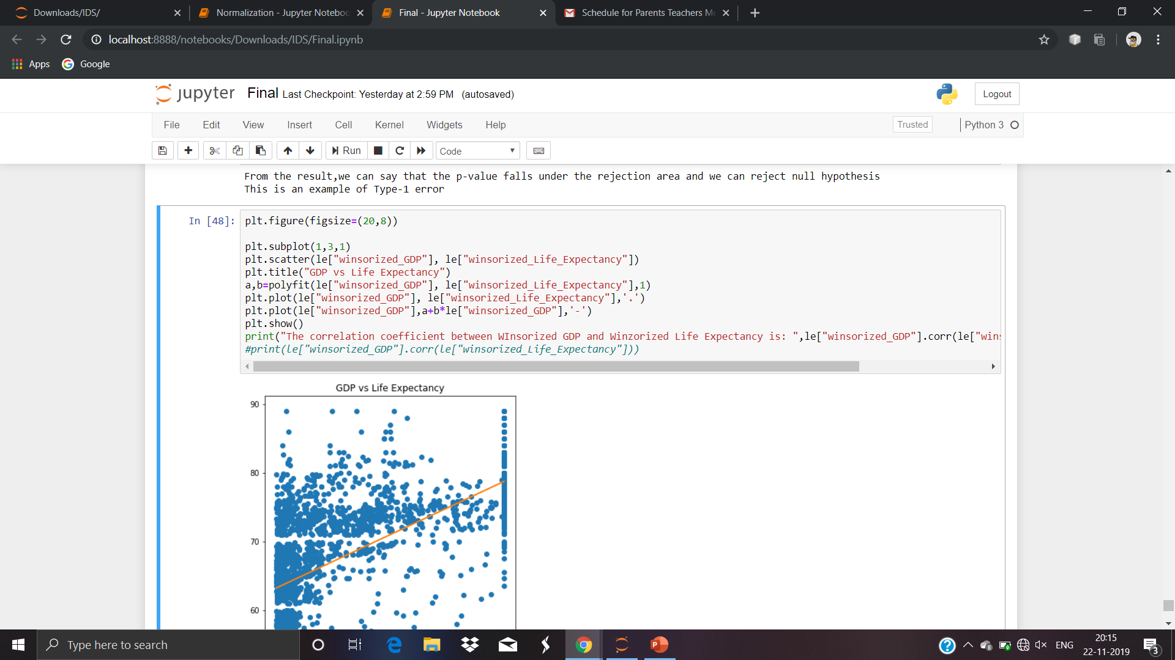
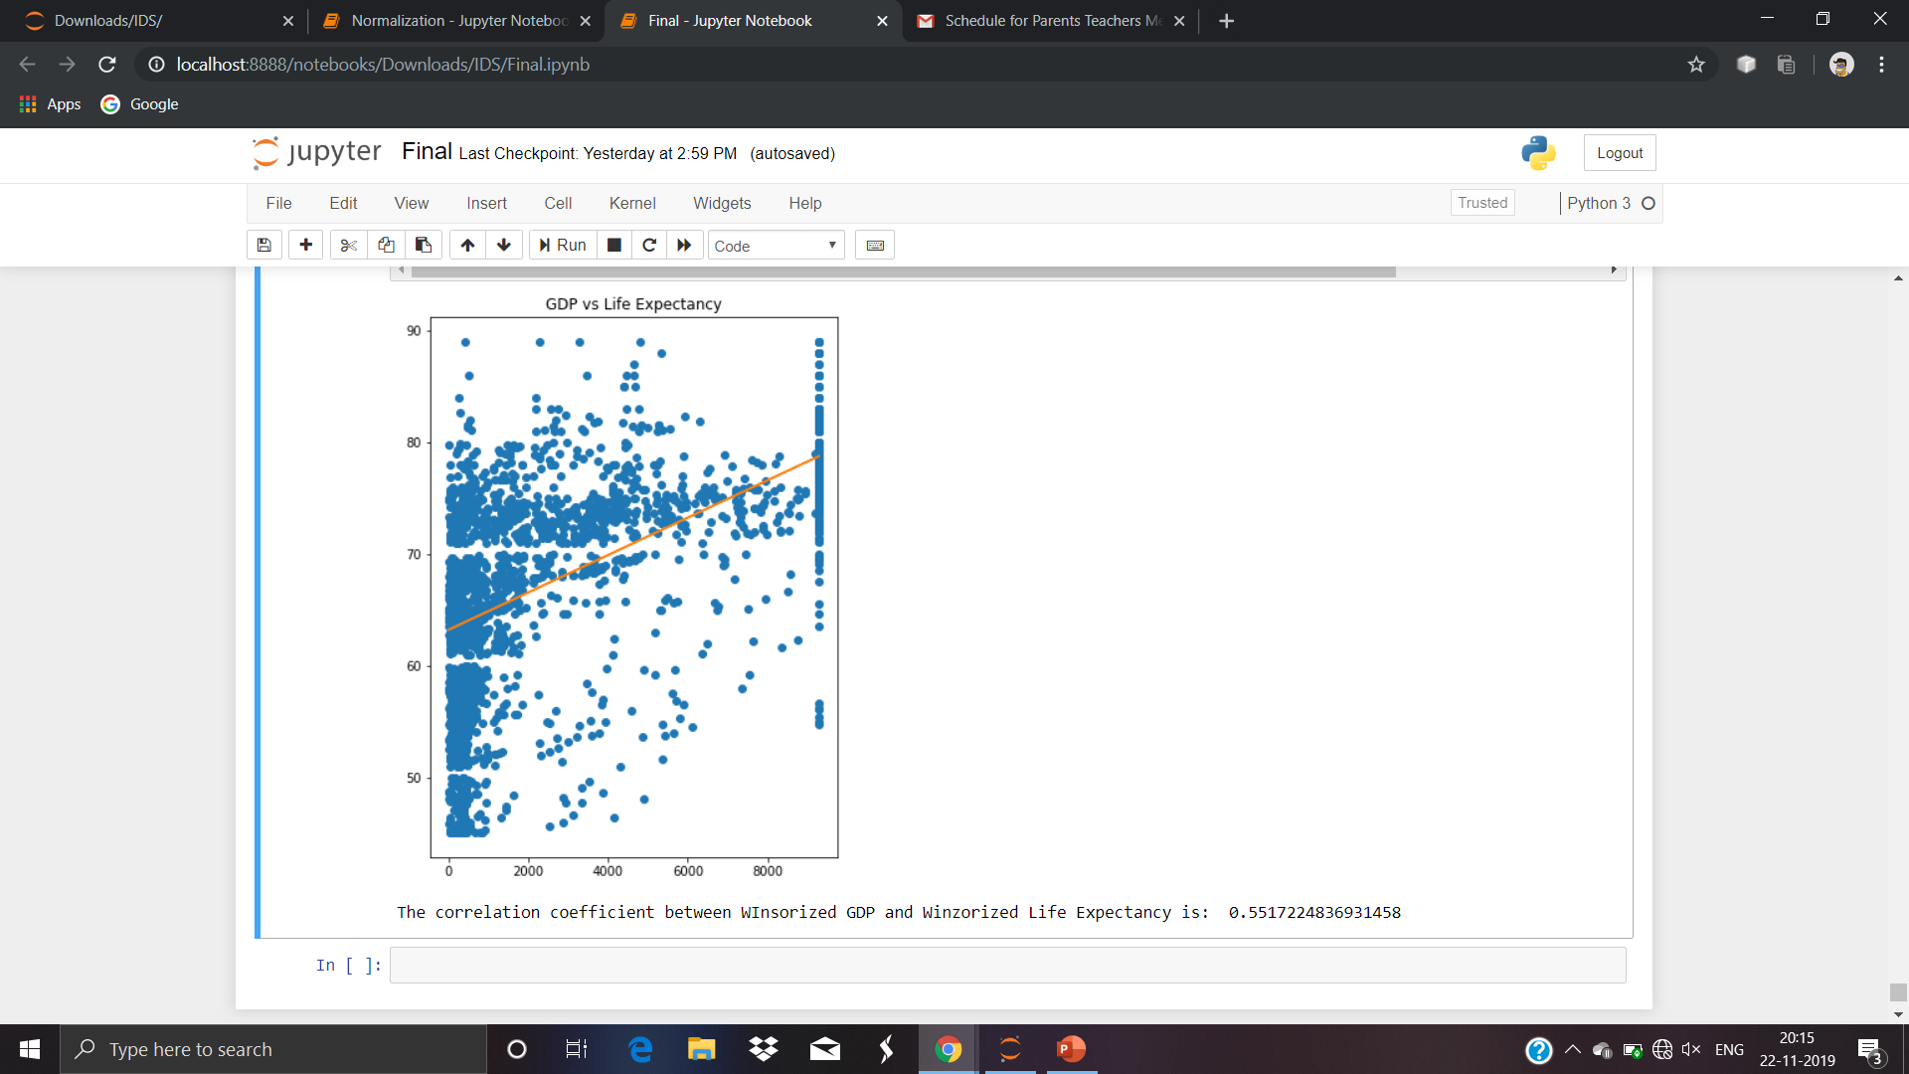
FINDING THE CORRELATION COEFFICIENT BETWEEN GDP AND LIFE EXPECTANCY

Slide 23
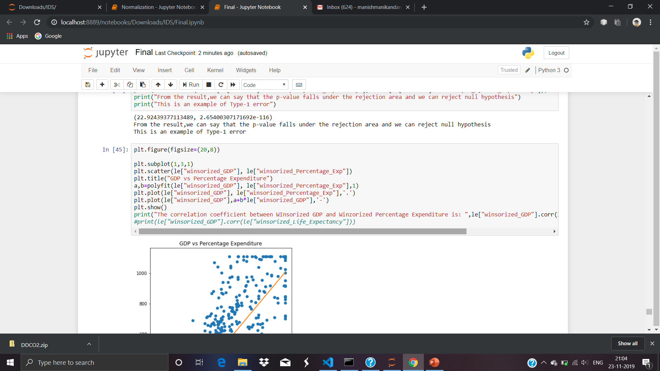

Slide 24
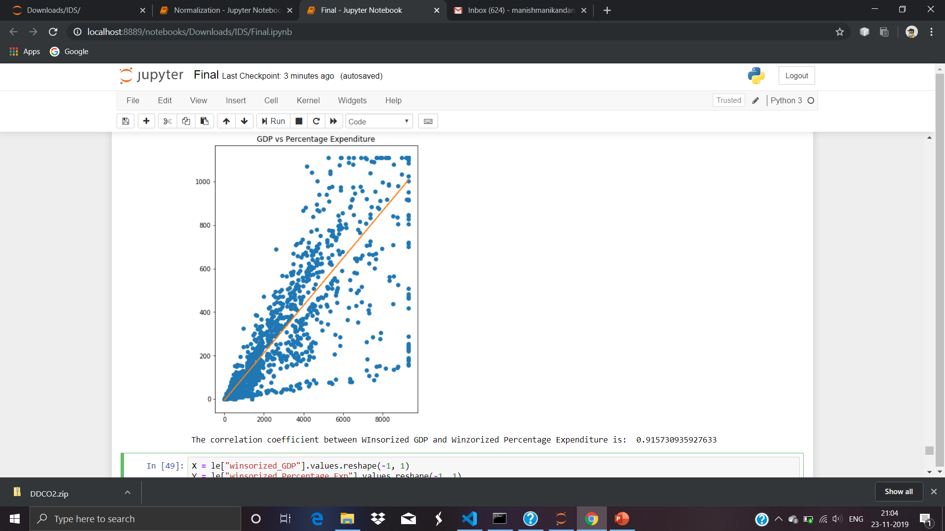

Slide 25
PERFORMING Z-TEST ON THE DATASET
Our null hypothesis states that the average life expectancy of a developed is country is greater than that of a developing country
But since the p-value found lies in the rejection area, we can say that this is a case of Type-1 error.

Slide 26
